Slide 1
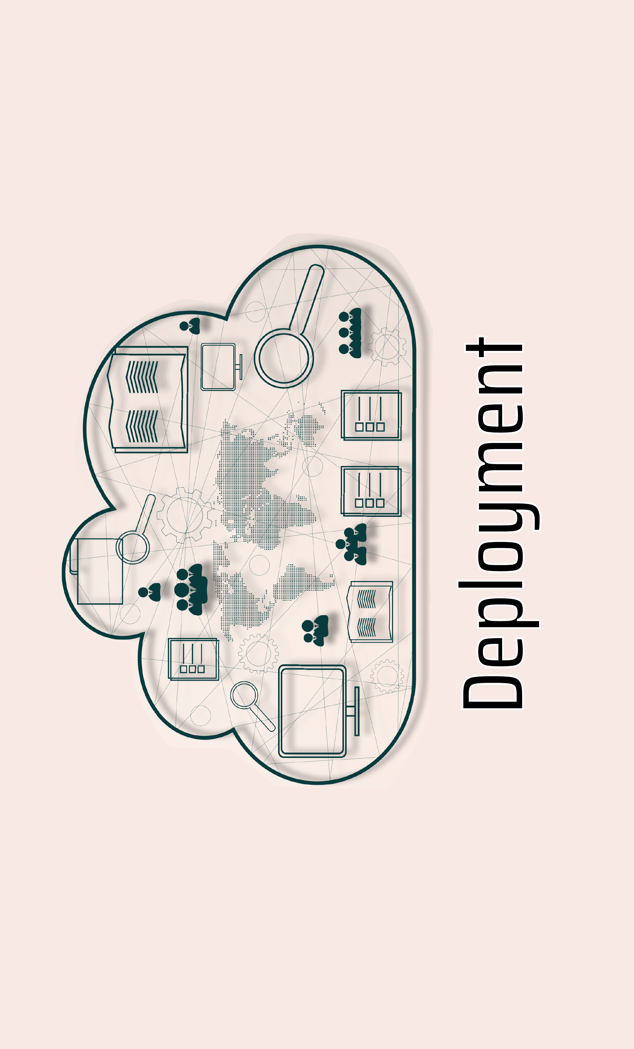
AWS, Google AI, Azure, IBM
Cloud-based Machine Learning
AMS-Master Program
Roatny NUON
12 Jul. 2023

Slide 2
Table of contents
01
02
03
04
Introduction
Cloud-based platform
How-to deploy
Conclusion

Slide 3
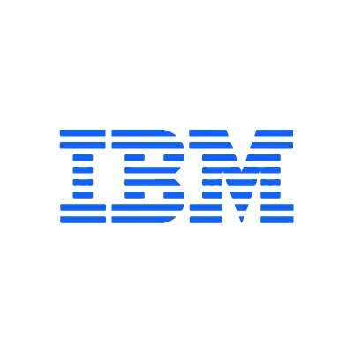
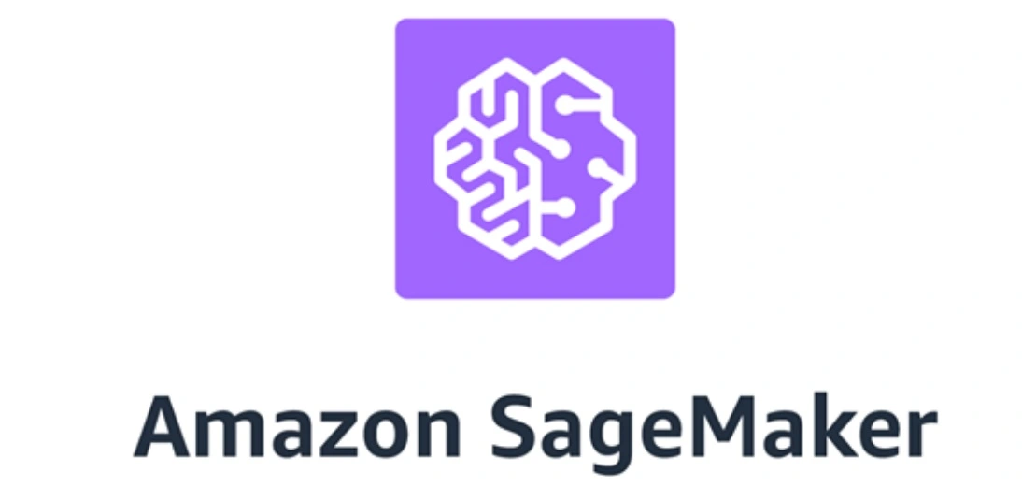



Introduction
Deployment of Machine leanring on Cloud-based mean:
Hosting and running machine learning models on cloud-based platform such as
It involve uploading model, setting up APIs and endpoints, and configuring computing resources. Once deployed, the machine learing models can be accessed & used by users over the internet.

Slide 4

Introduction (Con.)
Discuss the process of deploying machine learning models using cloud-based platforms such as AWS,Google AI, Azure, and IBM…
We will cover the steps involved in preparing a machine learning model for deployment, setting up a cloud environment, configuring infrastructure, deploying the model.

Slide 5

Why?
Scalability
Flexibility
Cost-effectiveness
Security
Easy to manage the model
No need to invest on hardware and infrastructure

Slide 6
Cloud_based Platforms
AWS | Google AI | Microsoft Azure | IBM | Hugging Face
ML tools & services SageMaker, Fully-managed platform for building, training, & deploying Tools for data storage, processing, and analytics. | Build, training & deploying ML model. Tools & services for data processing, training, & deployment Pre-built ML models for common use cases. | Building, training, & deploying ML. Tools & services for data preparation, model training, & deployment Integration w/ other Azure services | Build, traing & deploy ML Tools & service for data preparation, train & deploy Pre-build ML model for common use cases. | Build, traing & deploy NLP Pre-training for common NLP tasks such as tools for fine-tuning & deploying custom models.

Slide 7

How-to deploy

Slide 8
Basic workflow
1
2
3
4
Model preparing
Wrapping-Flask
Container_
Docker
Hosting on Cloud
Training, testing model with good algorithm, evaluate
Wrapping the inference logic into a flask application
Using Docker to containerize the flask application
Choose which cloud platform to host the docker

Slide 9
Model Preparation on local Machine
1
Prepare machine learning for deployment
Training, testing model
Choosing the best algorithm, hyperparameters
Evaluate the model’s performance

Slide 10
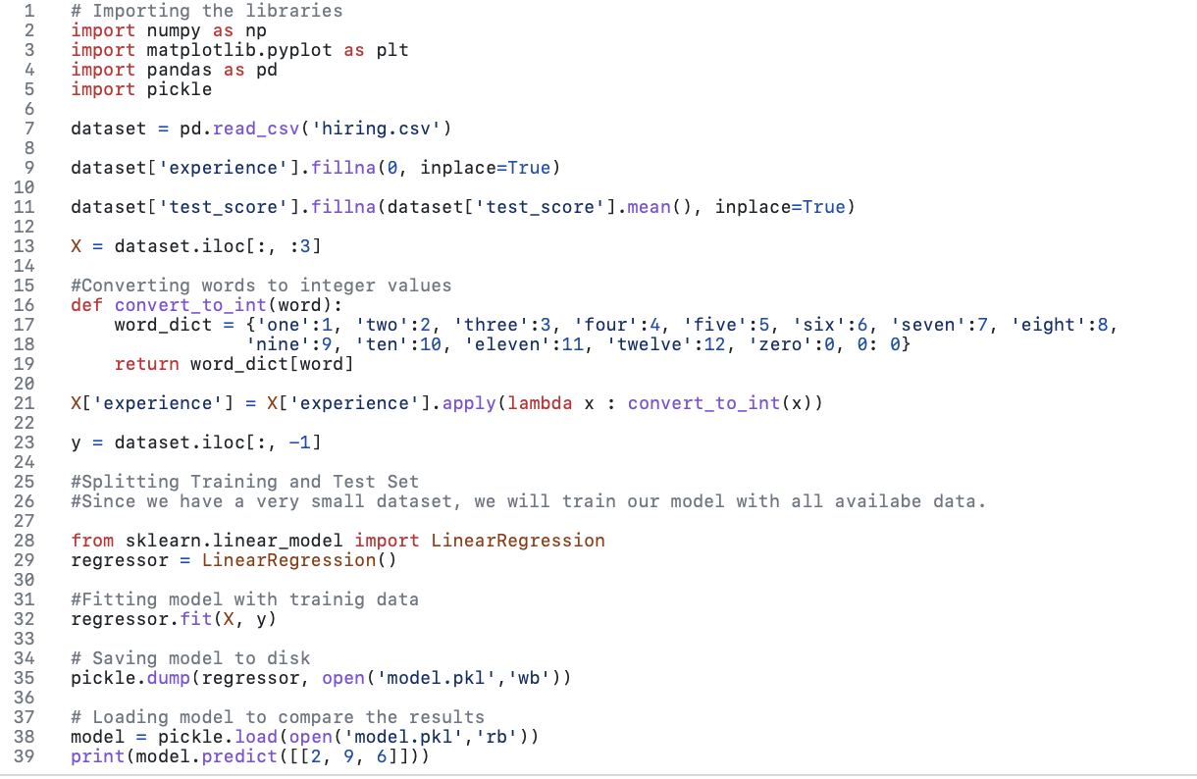

Example: Model Code
Source: github krishnaik06

Slide 11


2
Wrapping the inference by flask
Using flask to build the inference as a web-service
It allows us to build REST API based web-services quickly with minimum configuration hassle.

Slide 12
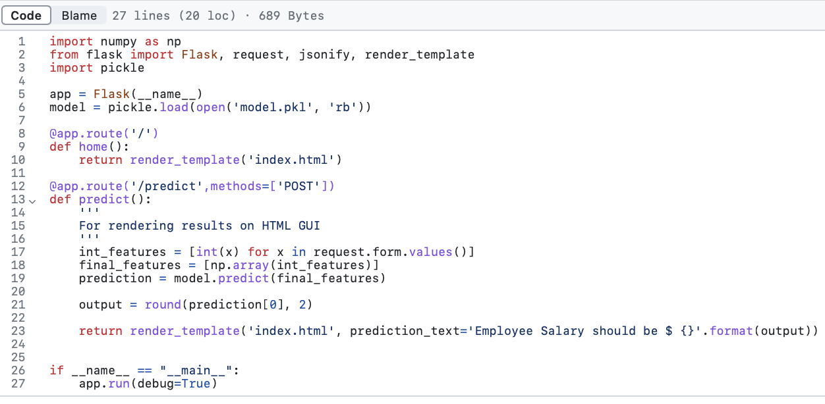
Example: Flask App Code

Slide 13
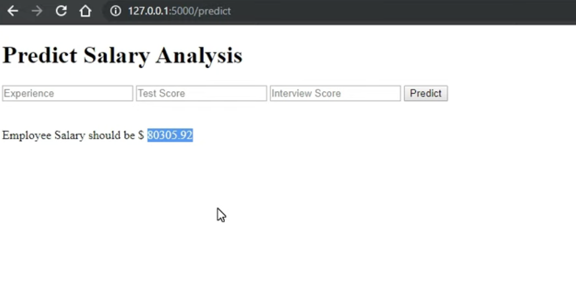
Example: App Result

Slide 14

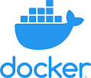
3
Using docker
to containerize
the flask service

Slide 15
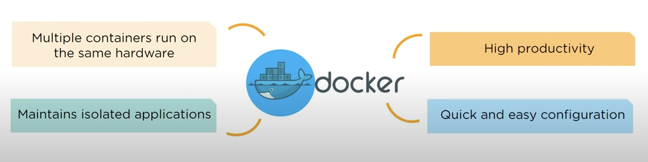
3. Using docker to containerize the flask service
‘But it worked on my machine!’
Docker is a tool which is used to automate the deployment of applications in lightweight containers so that applications can work efficiently in different environments.
Source: Simplilearn

Slide 16
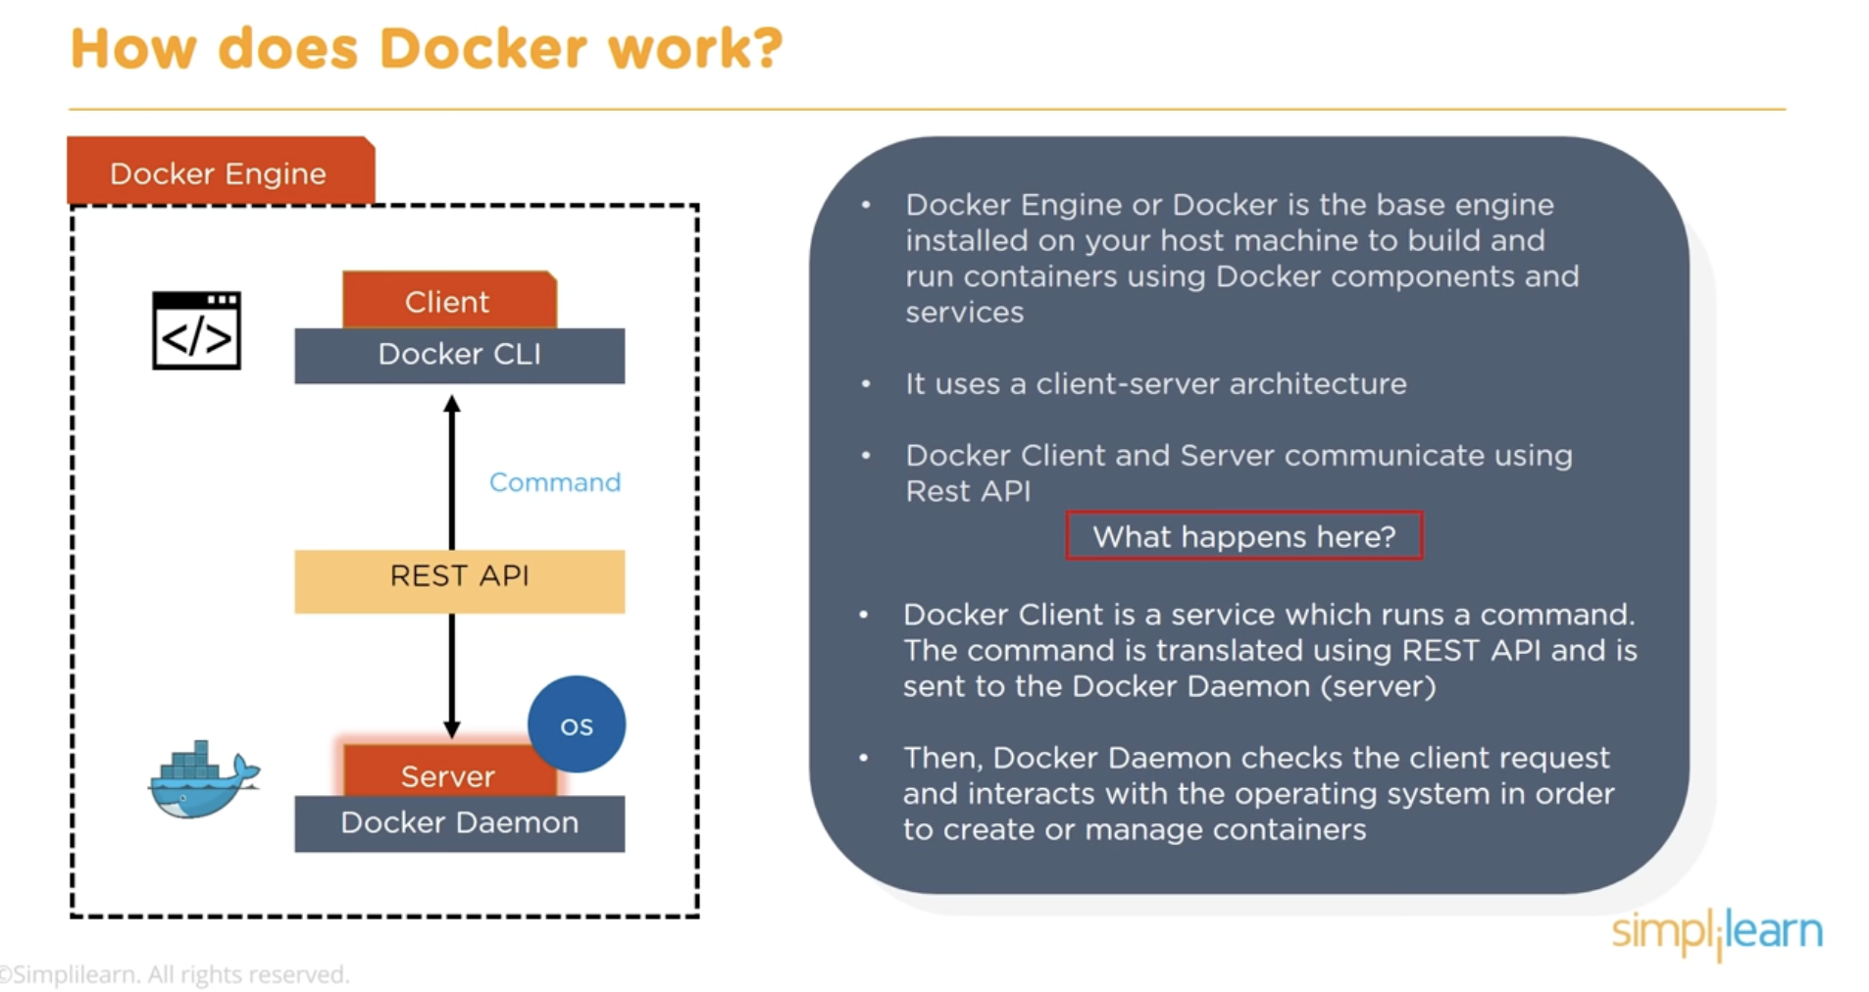
How Docker work?
Source: Simplilearn

Slide 17
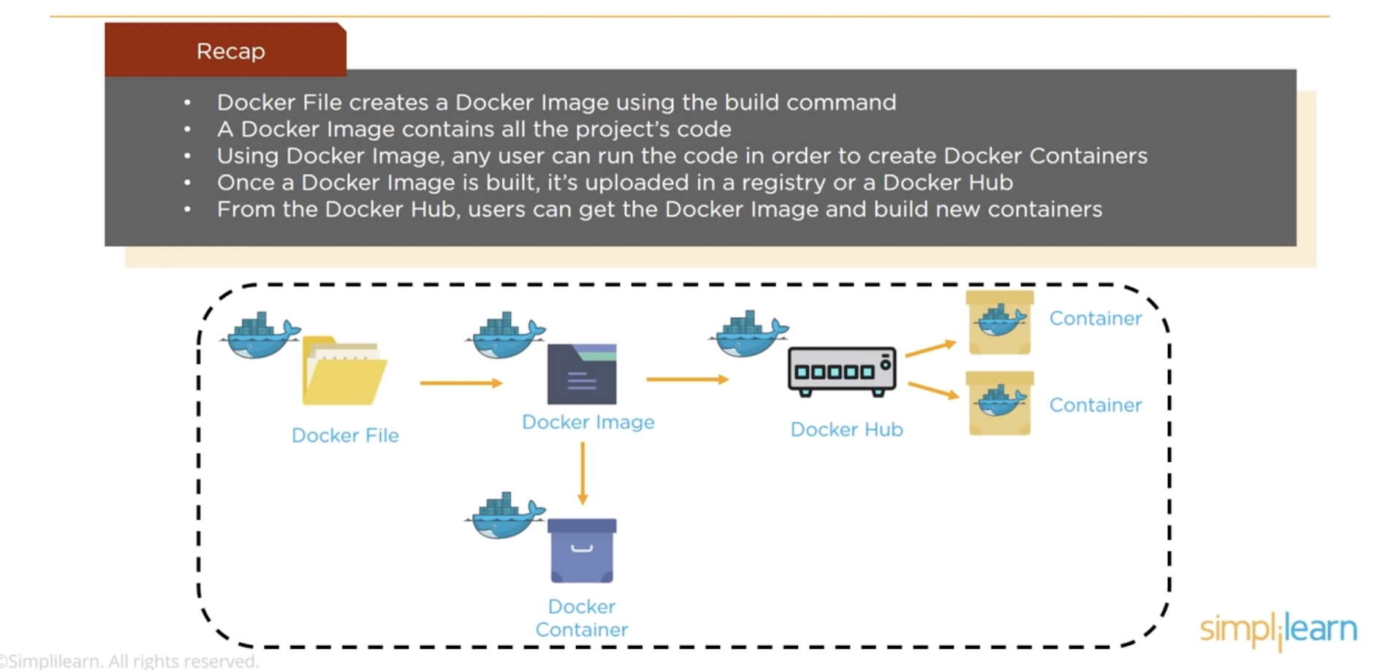
How Docker work?
Source: Simplilearn

Slide 18
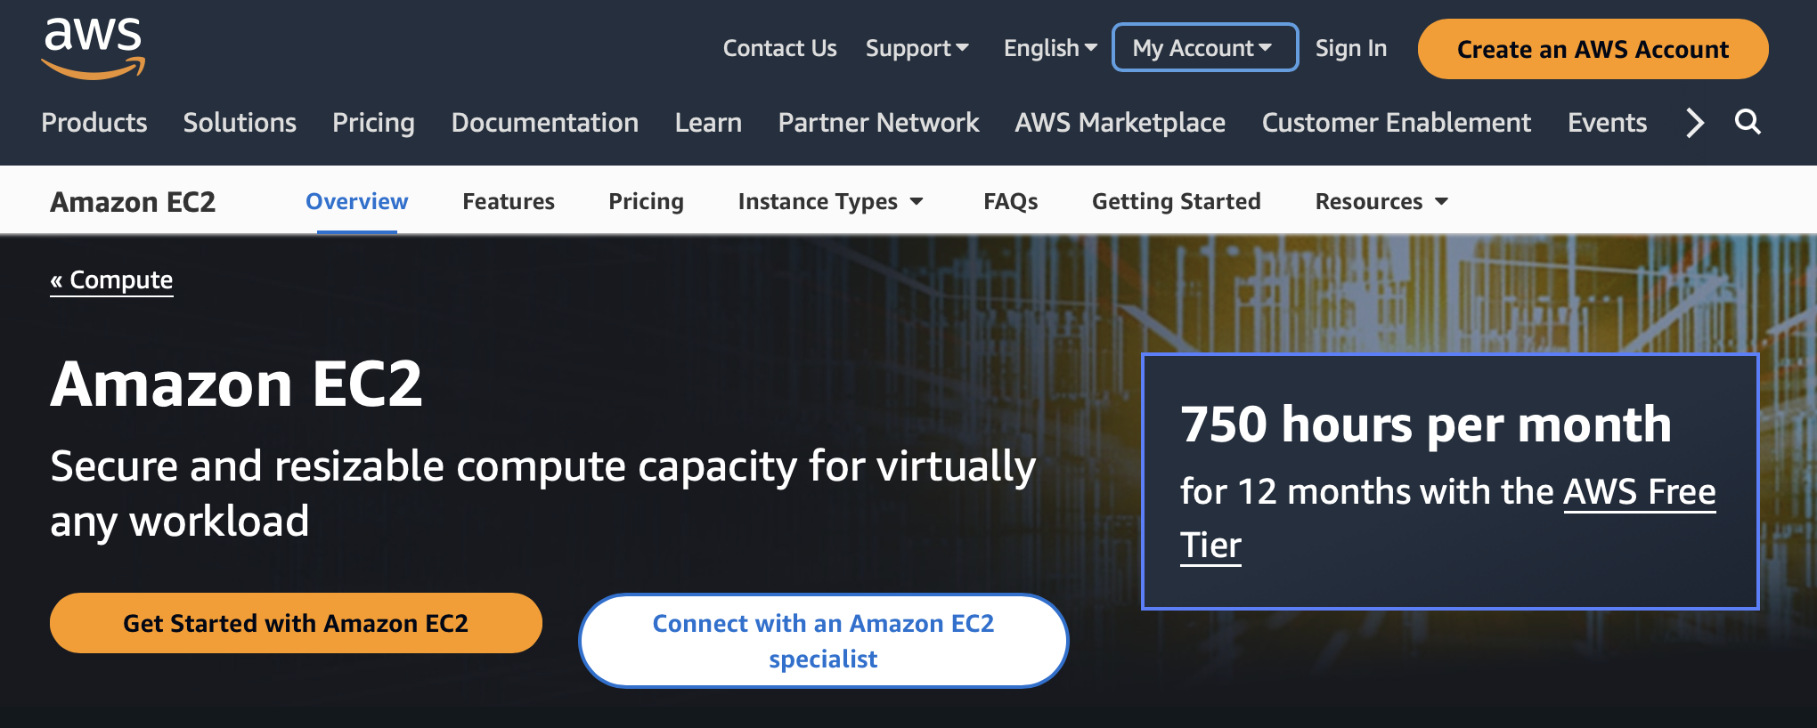
Hosting the docker container on Cloud
4
what if someone else wishes to consume the service?
Choose the cloud-based platform, and now let use AWS

Slide 19


Photo showcase

Slide 20
Thank You !
AMS-Master Program
Roatny NUON

Slide 21
Alternative resources
c

Slide 22
References
Simple way to deploy machine learning models to cloud
Cloud Deployment Models
Simplilearn: https://youtu.be/rOTqprHv1YE

